Slide 1
SALES INSIGHT & PROFIT ANALYSIS
File created on: 25-07-2023 13:57:35

Slide 2
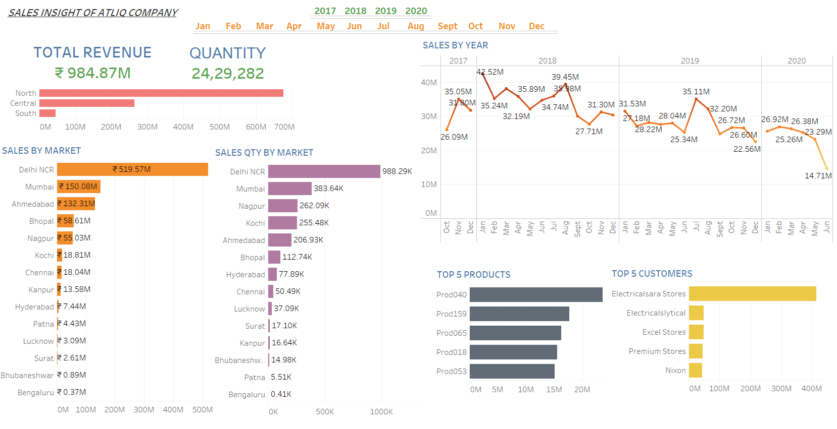

Slide 3
